Slide 1
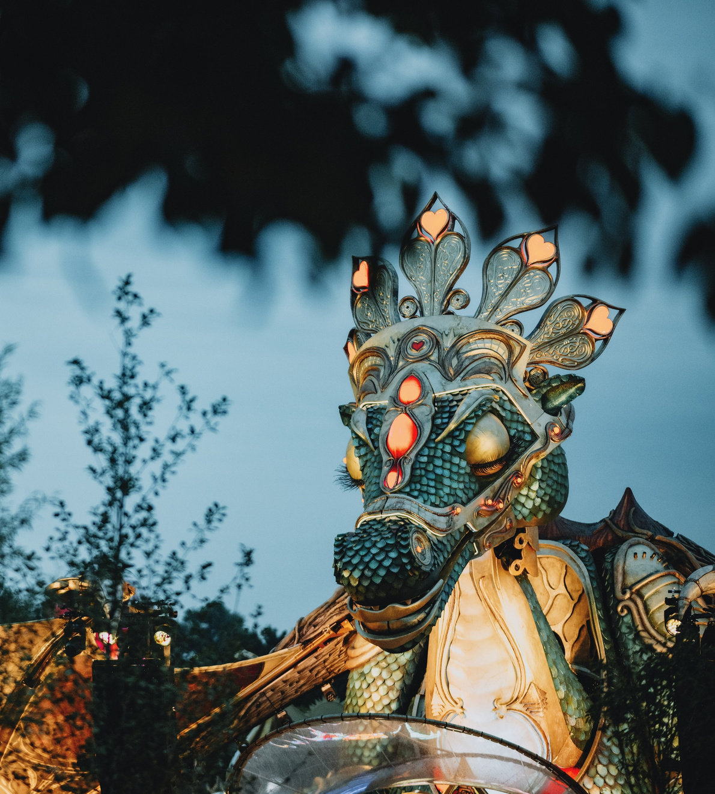

S O C I I S G R O U P
in collaboration with Love Tomorrow
The world gathers outside.
Three hundred step inside.
The 300
Shape Tomorrow Today.
2 3 J u l y 2 0 2 6 · O n t h e i c o n i c g r o u n d s o f T o m o r r o w l a n d
€850 excl. VAT per seat · €8,500 excl. VAT per Founding Table
Notes:
1

Slide 2
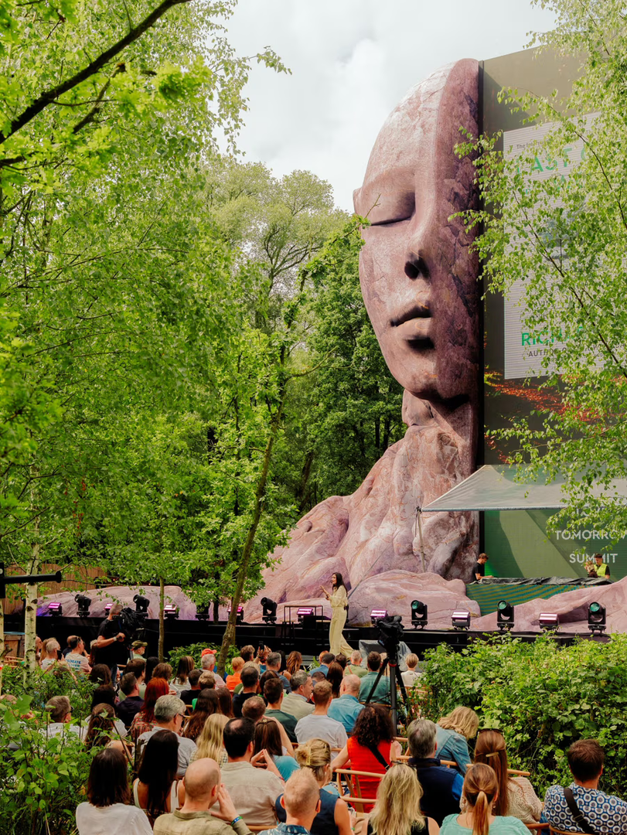
T H E 3 0 0
A room within the Summit.
On 23 July 2026, SociisGroup opens its largest room.
On the iconic grounds of Tomorrowland, in collaboration with Love Tomorrow.
A SociisGroup room held inside a global cultural moment that three billion people know by name. The day carries its own name. Shape Tomorrow Today.
SociisGroup is the independent behavioural institution. We serve humanity by changing how the world behaves.
Tomorrowland · the iconic grounds
0 2 / 0 7
Notes:
2

Slide 3
T H E 3 0 0
The day.
T H E O P E N I N G
A V O I C E F R O M W B C S D
A live cultural opening that sets the day in motion.
Dr. Ilham Kadri, Chair, World Business Council for Sustainable Development.
T H E K E Y N O T E
D E F I N I N G M O M E N T S
One voice. One hour. The question the room needs to hear.
Sarah McArthur on Frances Hesselbein. The film, then Sarah speaks.
V O I C E S F R O M T H E R O O M
L E T T H E R E B E L I G H T
International leaders. Each with one thing to say.
The cultural anchor of the institution. Featuring Jean Bosco Safari.
L U N C H O N T H E G R O U N D S
T H E C L O S E
Seated lunch. Tables curated. Love Tomorrow VIP surrounds you.
A final movement. The room ends when it is ready.
The day closes with a moment we do not announce in advance.
0 3 / 0 7
Notes:
3

Slide 4
T H E 3 0 0
Voices in the room.
Dr. Ilham Kadri
Sarah McArthur
Dr. Tessy Ojo CBE
Chair, WBCSD
Editor-in-Chief, Leader to Leader
CEO, The Diana Award
Stefano Fallaha
Tim Sanders
Iris van der Veken
Founder & CEO, Podeo
Founder & CEO, Silent Donor
Ambassador, SociisGroup
Mikkel Juel Iversen
Jean Bosco Safari
Founder, Under One Sky
Let There Be Light, Cultural Anchor
All participants attend in a personal capacity. Further voices forming.
0 4 / 0 7
Notes:
4

Slide 5
T H E 3 0 0
What your seat includes.
  Full-day access to The 300, the room for three hundred curated individuals
  Love Tomorrow VIP pass. Food, drinks, special area access, parking
  The Keynote, one voice held for this room
  Dr. Ilham Kadri, Chair, WBCSD, as a voice in the room
  Voices from the Room. International leaders, each with one thing to say
  Defining Moments, Sarah McArthur on Frances Hesselbein
  Let There Be Light, the cultural anchor. Featuring Jean Bosco Safari
  Access to Sociis House, the continuous environment of the institution
F O U N D I N G T A B L E
A table of ten.
Closes 31 May 2026.
  Ten seats on the iconic grounds, curated together
  Curated host placement during the room
  Priority placement near the cultural anchor
  Permanent recognition in the institutional record
€8,500
e x c l u d i n g V A T
0 5 / 0 7
Notes:
5

Slide 6
T H E 3 0 0 · F O U N D I N G W E E K E N D
For those who carry both days.
The 48-Hour Arc Table.
4 8 - H O U R A R C T A B L E
Across the weekend.
The founding-weekend table for those who stand with the institution across both days.
Closes 31 May 2026.
  One table at The 64 in Brussels on 22 July
  One table at The 300, on the iconic grounds, on 23 July
  Name on the Founding Wall at Corinthia Brussels
  A private founder moment during The 64
  Permanent recognition in the institutional record
22 July · Brussels
23 July · Iconic grounds
Founding Wall · Corinthia Brussels
€30,000
e x c l u d i n g V A T
0 6 / 0 7
Notes:
6

Slide 7
Hold your seat.
One confidential alignment conversation.
N o p r e s s u r e . O n l y c l a r i t y .
hello@sociisgroup.com
All prices exclusive of 21% Belgian VAT. Curation applies. SociisGroup reserves the right to decline participation.
Notes:
7

